Slide 1
ADAM 1.0 – a tutorial under construction
Johannes Fahrenfort

Slide 2
What we’ll cover
Setting up
BDM first level analysis (decoding)
Group statistics and visualization
Not covered today:
Pre-processing
How scripts work with Linux computing cluster
FEM analyses (forward modelling)

Slide 3
scripts
An easy zip with all required toolboxes for this tutorial (including ADAM) can be downloaded from here: XXX
Latest ADAM version can always be downloaded from Github: https://github.com/fahrenfort/ADAM
Follow the install instructions in ‘install_instructions.txt’

Slide 4
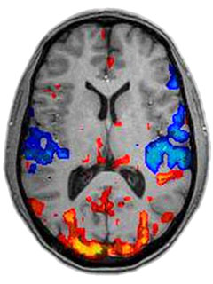
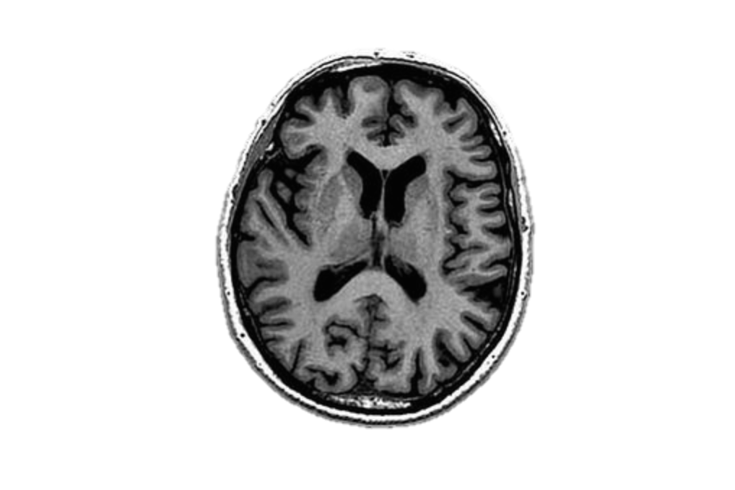
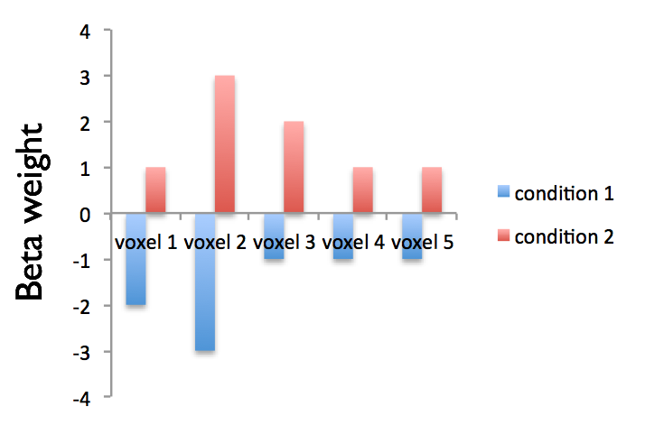
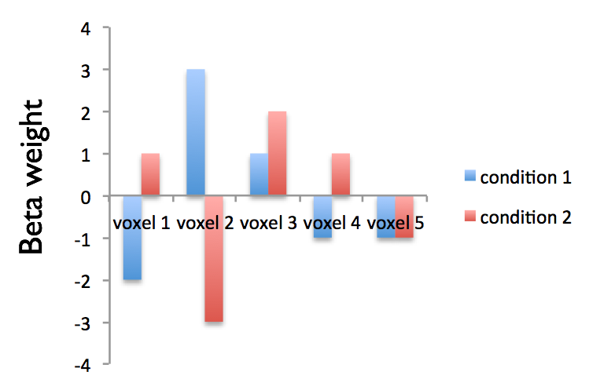
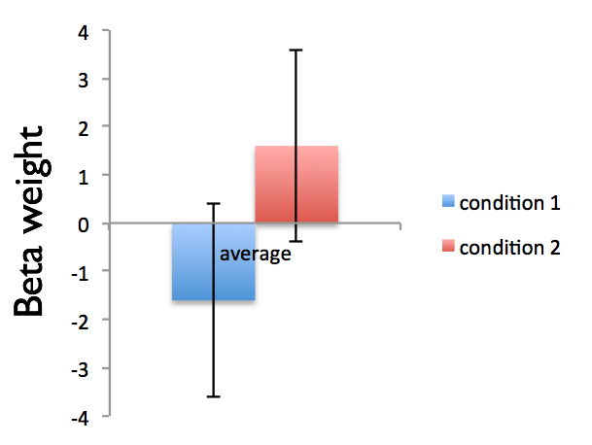
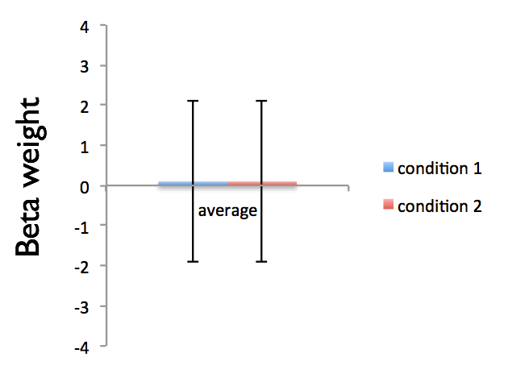
Univariate versus multivariate
An example from fMRI
Univariate differences -> patterns of activation

Slide 5
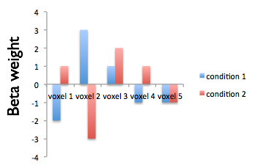
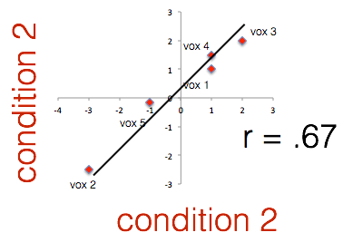
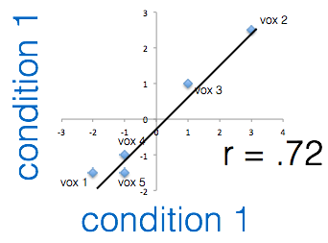
MVPA
Patterns might be very consistent over trials!

Slide 6
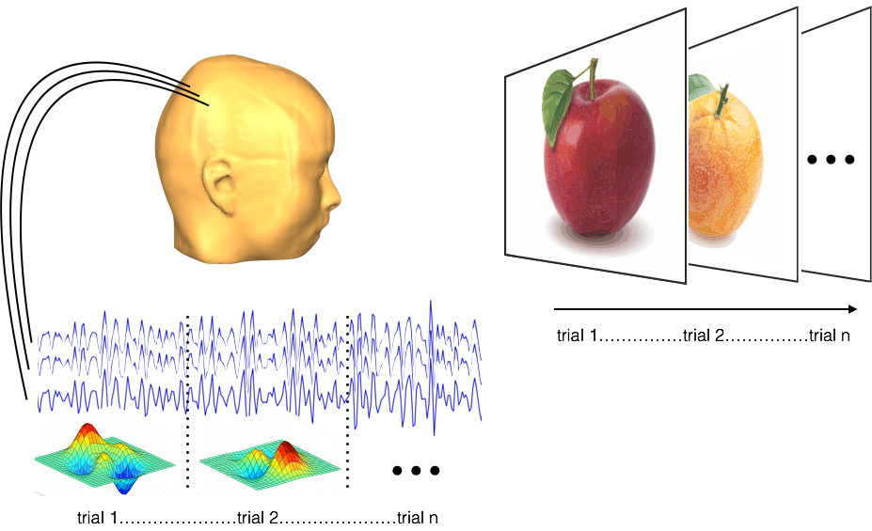
Acquire EEG

Slide 7
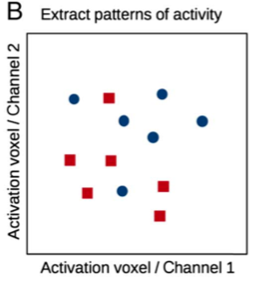
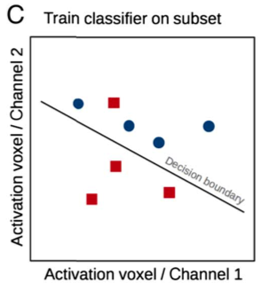
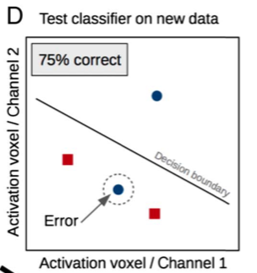
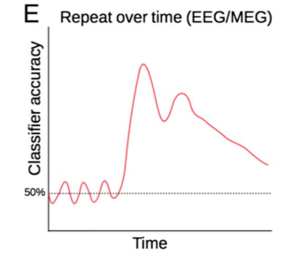
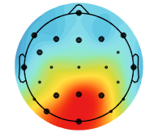
Decoding approach
Plot activation patterns
(equivalent to univariate)
cov_matrix * weights
Grootswagers, T., Wardle, S. G., & Carlson, T. A. (2017). Decoding Dynamic Brain Patterns from Evoked Responses: A Tutorial on Multivariate Pattern Analysis Applied to Time Series Neuroimaging Data. Journal of Cognitive Neuroscience, 29(4), 677–697.

Slide 8
Workflow
No GUI
Preprocessing
MVPA first level analysis
Compute group stats
Visualize group stats

Slide 9
Pre-processing (not covered today)
Up to you, as long as the data are EEGLAB format (.set files) or FieldTrip format (.mat files)
My personal pipeline:
Read into EEGLAB
Resample to 512 Hz (if applicable)
Highpass filter (.1 Hz)
Epoch data, use numbers for condition labels
Remove eye-blinks using ICA (not always necessary)
Remove eye movements using customized ERPLAB script
Remove muscle artifact using customized fieldtrip script (for raw EEG data this is usually sufficient) or remove artifcts by visual inspection (best for time-frequency analysis)
Some easy to use pre-processing scripts for running ICA etc are contained in the toolbox

Slide 10
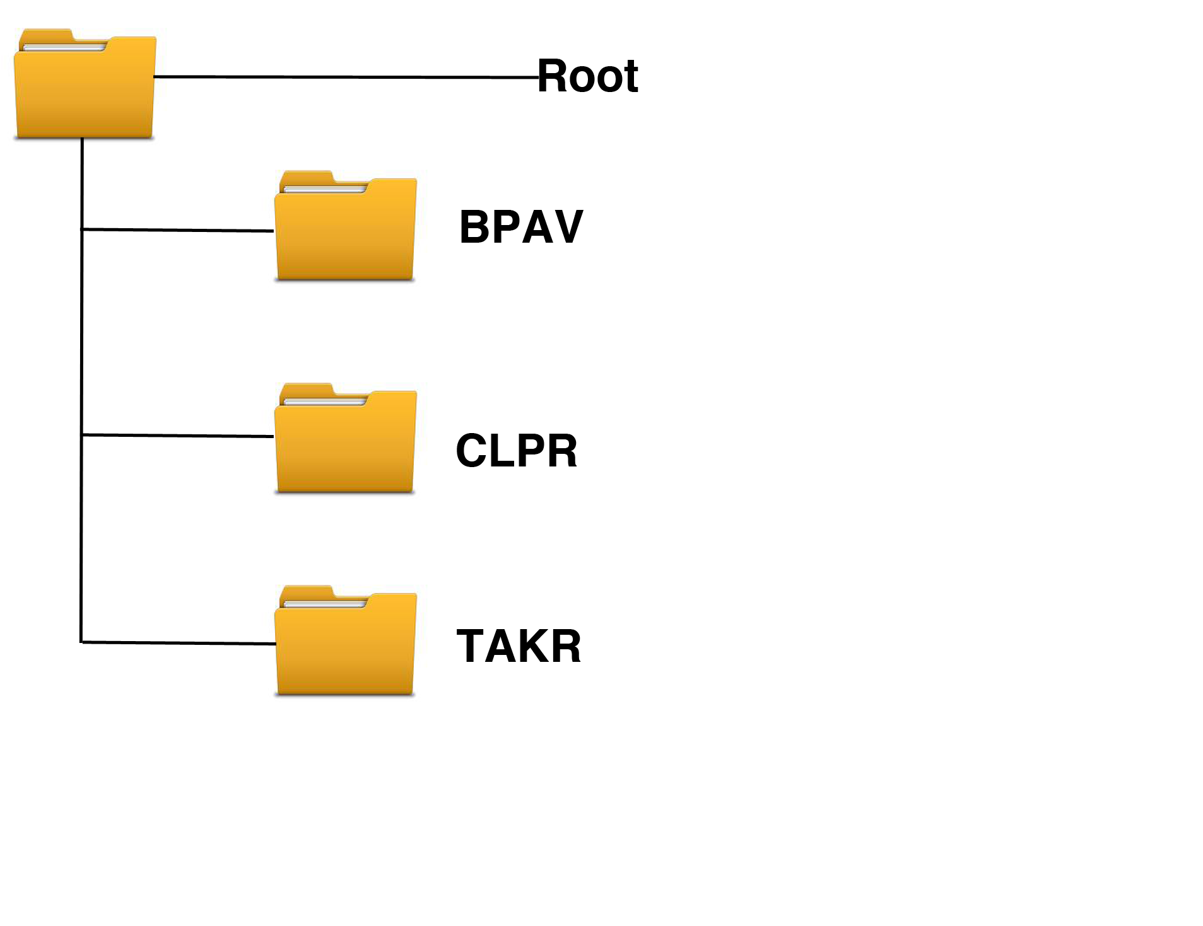
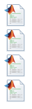
Organization of scripts
Experiment-specific scripts
These contain the scripts to run and visualize a particular analysis
Core toolbox functions
matlab_toolboxes
scripts
run_pre_processing.m
run_RAW_eeglab_decoding.m
run_TFR_decoding.m
run_plotting.m
ADAM_master
behavior
eeg_preprocessing
eeg_mvpa
… etc
eeglab14_1_1b
I will provide examples of what these could look like during this tutorial
fieldtrip-20170704

Slide 11
MVPA first level analysis
Functionality - two core functions:
classify_RAW_eeglab_data.m
classify_TFR_data_from_eeglab.m
Always the same structure:
function(filepath,filenames,outpath,<varargs>)

Slide 12
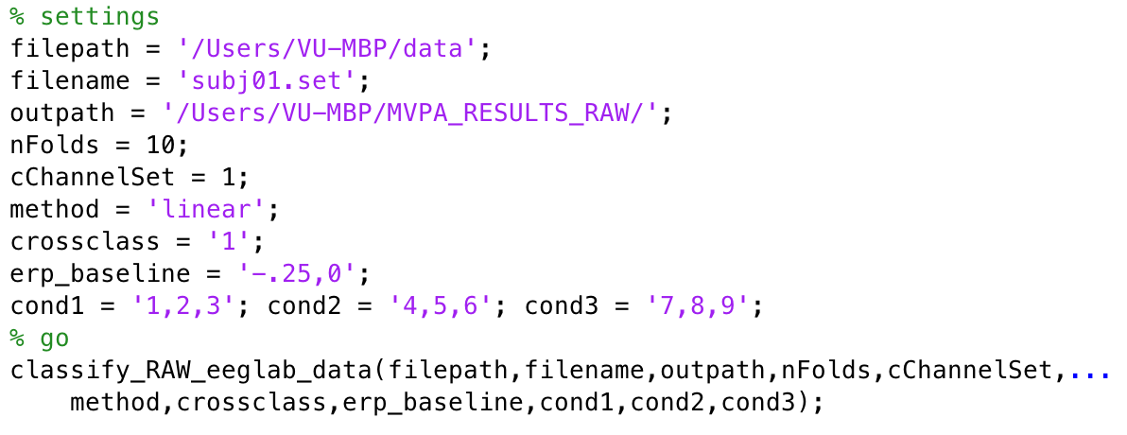

classify_RAW_eeglab_data.m
Performs MVPA analysis on eeglab data
Assume we want to perform analysis on one subject, running locally inside matlab:

Slide 13
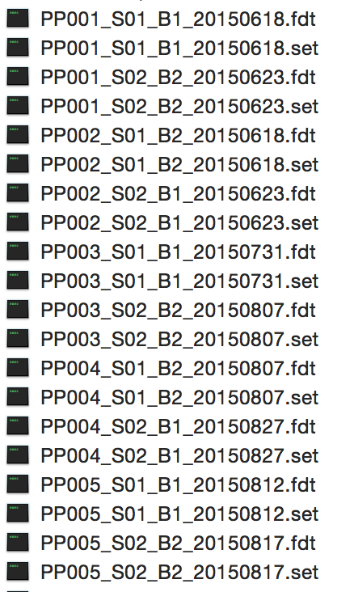
/Users/VU-MBP/data

Slide 14
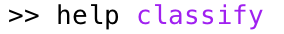
settings
nFolds = how many folds you want to use in k-fold leave-one-out procedure
cChannelset = predefined channelsets to select electrodes (1 = uses all electrodes; 2 = uses occipital electrodes, 3 = uses parietal electrodes etc.), or like this 'Oz,Pz,Iz’
method = the method the LDA uses (e.g. linear), see and other options (e.g. hr-far, bin, bintrain, bintest, randperm), see

Slide 15
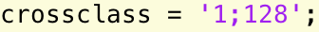
settings
crossclass = compute only along the diagonal or compute the Generalization Across Time (GAT) matrix. This takes a LOT of time. You can add a second value to downsample the signal, like this: e.g. to downsample to 128 Hz (faster).
erp_baseline = baseline that should be used for each trial, e.g. uses a baseline between -250 and 0 ms.

Slide 16
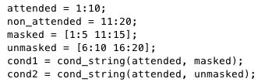
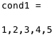
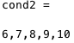
settings
conditions: indicate the condition classes you want to do classification for, should be string!
Very useful function: cond_string.m

Slide 17
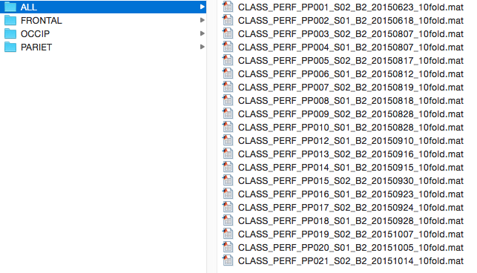
example in output folder (20 subjects)
the channel set that was used

Slide 18
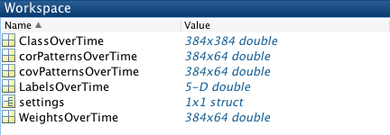
example output in matlab (1 subject)

Slide 19
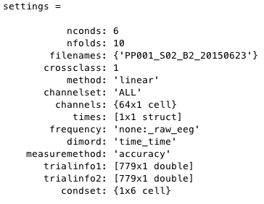
settings

Slide 20
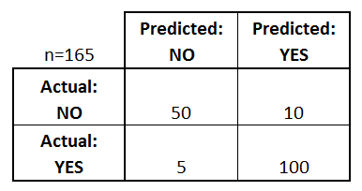
Confusion matrix
A confusion matrix is a table that is used to describe the performance of a classification model (or "classifier") on a set of test data for which the true values are known.

Slide 21
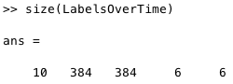
LabelsOverTime
Confusion matrix: folds * time (test) * time (train) * stimclass (actual) * stimclass (classifier)

Slide 22
ClassOverTime
Example average accuracy performance:
n= 60
Perf = 50/60 = .83
n= 105
Perf = 100/105 = .95
Average performance = (.83 + .95)/2 = .89
(so NOT 150/165 = .91!)

Slide 23
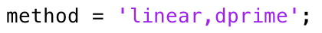
ClassOverTime
You can also compute hr-far, d’ and other SDT measures (see help). This can only be done when you have only signal and noise. To do this, specify: or When you do this, the first label should always be the signal, and the second label the noise stimulus!

Slide 24
ClassOverTime

Slide 25
classify_TFR_data_from_eeglab.m
The same principle, but now for time frequency
This is a wrapper function which internally uses classify_TFR_data.m and compute_TFR_from_eeglab.m
For help on MVPA settings do:
For TFR settings do (and/or modify):

Slide 26
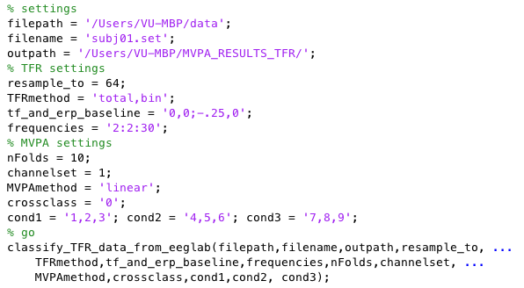
classify_TFR_data_from_eeglab.m
Running locally inside matlab:
Other options are:
‘evoked’ and
‘induced’ power

Slide 27
TFR settings
resample_to = New sampling rate for the TFR analysis. Since the TFR signal is already intrinsically temporally smoothed, you don’t require all time samples.
TFRmethod: total, evoked or induced, do you want total, evoked or induced TFRs. bin: do you want to take the average of the condition labels in each condition.
Frequencies: can run up to 100, take frequency steps of 2.

Slide 28
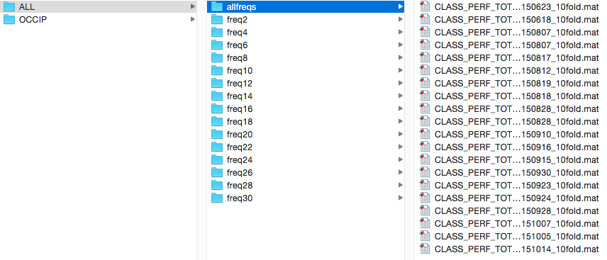
example in output folder (20 subjects)
frequency * time, all frequencies
time * time, separately for each frequency

Slide 29
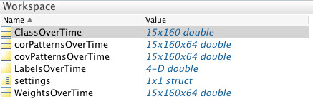
example output (1 subject)

Slide 30
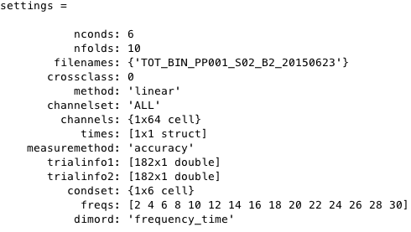
settings

Slide 31
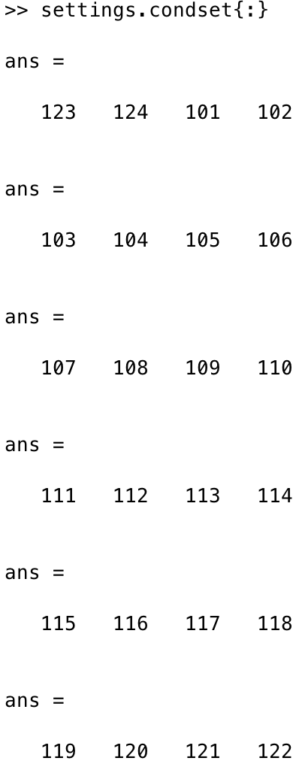
settings
cond1
cond2
cond3
cond4
cond5
cond6

Slide 32
ClassOverTime

Slide 33
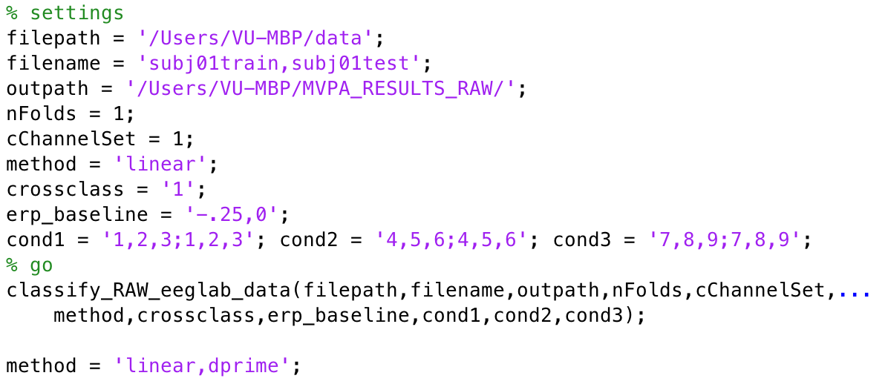
Things to note
You can also indicate that you want to use a different dataset for training and for testing
For example like this:
training file testing file
training labels testing labels

Slide 34
Group statistics and plotting
Statistics
RAW:
2D (only diagonal)
3D (Generalization Across Time: GAT)
TFR:
3D (frequency-time)
3D (GAT, for a specific frequency)

Slide 35
Three core functions
Functionality: computing group averages + stats and plotting the classification results + topomaps
compute_group_MVPA.m
plot_MVPA.m
plot_MVPA_weights.m
First run compute_group_MVPA, then plot the result using plot_MVPA

Slide 36
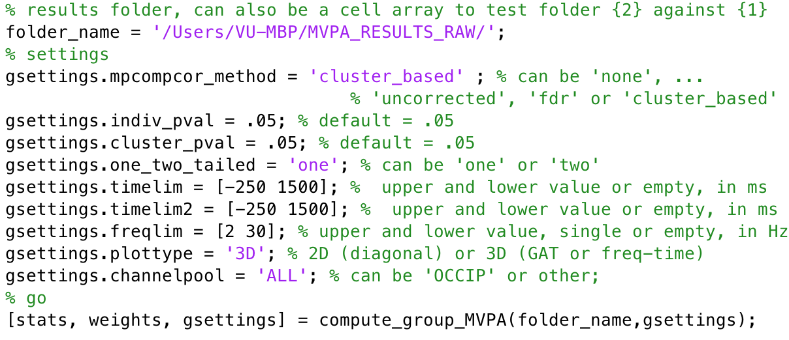
compute_group_MVPA.m
cluster_based, see: Maris, E., & Oostenveld, R. (2007). Nonparametric statistical testing of EEG- and MEG-data. Journal of Neuroscience Methods, 164(1), 177–190. http://doi.org/10.1016/J.Jneumeth.2007.03.024
fdr, see: Benjamini, Y., & Hochberg, Y. (1995). Controlling the False Discovery Rate - a practical and powerful approach to multiple testing. Journal of the Royal Statistical Society Series B-Methodological, 57(1), 289–300.

Slide 37
output of compute_group_MVPA.m
stats
weights
gsettings

Slide 38
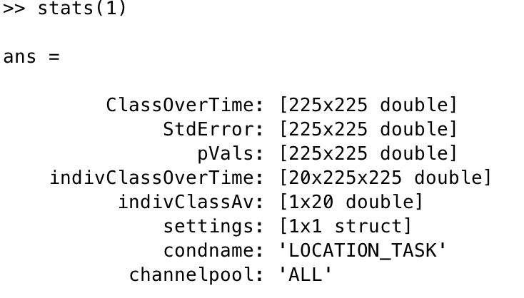
stats

Slide 39
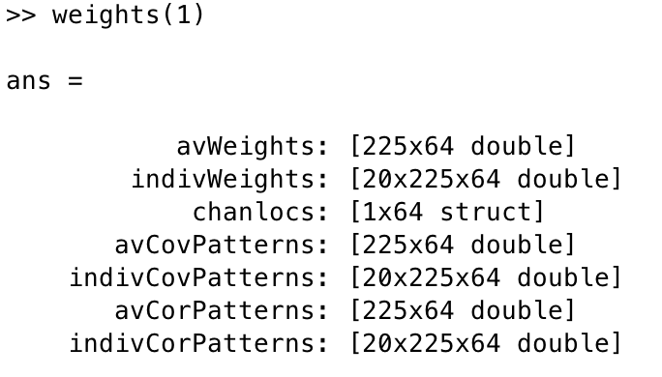
weights
CovPatterns and CorPatterns are the product of weight matrix and data covariance and correlation matrix respectively. They are interpretable as neural sources, see
Haufe, S., Meinecke, F., Goergen, K., Daehne, S., Haynes, J.-D., Blankertz, B., & Biessgmann, F. (2014). On the interpretation of weight vectors of linear models in multivariate neuroimaging. NeuroImage, 87, 96–110. http://doi.org/10.1016/j.neuroimage.2013.10.067

Slide 40
gsettings
What you specified 4 slides back

Slide 41
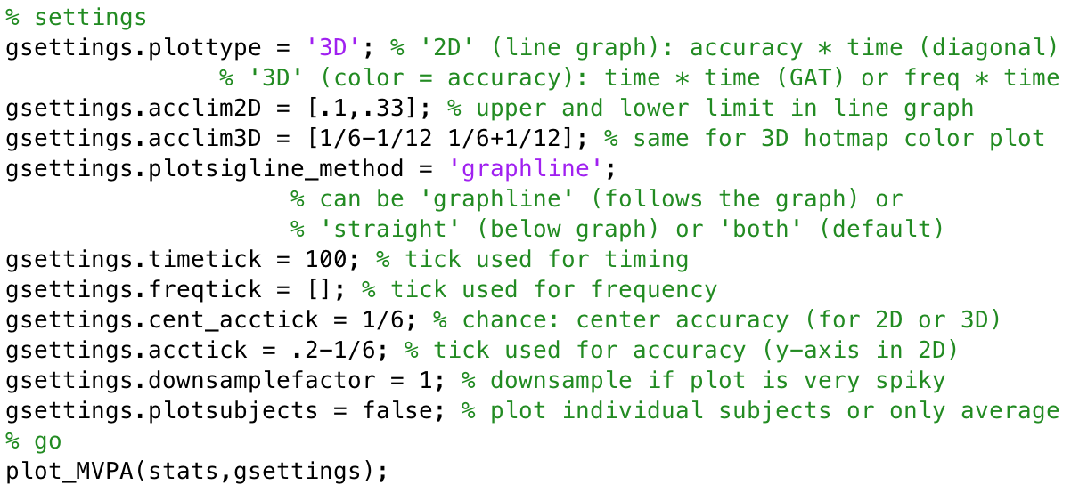
plot_MVPA.m
Add on to gsettings

Slide 42
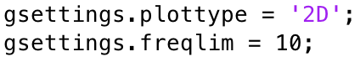
2D plot

Slide 43
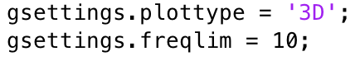
3D (GAT)

Slide 44
3D (time-frequency)

Slide 45
2D (frequency = 10)

Slide 46
3D (GAT, frequency 10 Hz)

Slide 47
Other stuff:
Extract values from your matrices: mask is a matrix that has the same size as stats.ClassOverTime, containing 1’s for regions that should be extracted and 0’s elsewhere. It outputs averages(cRoi,cCond,cSubj)

Slide 48
Weight and source topoplots
Only works properly when you include all electrodes in the MVPA analysis of course
Only makes sense when you plot the relation between two stimulus classes (scripts currently also only work when the initial analysis had two stimulus classes)

Slide 49
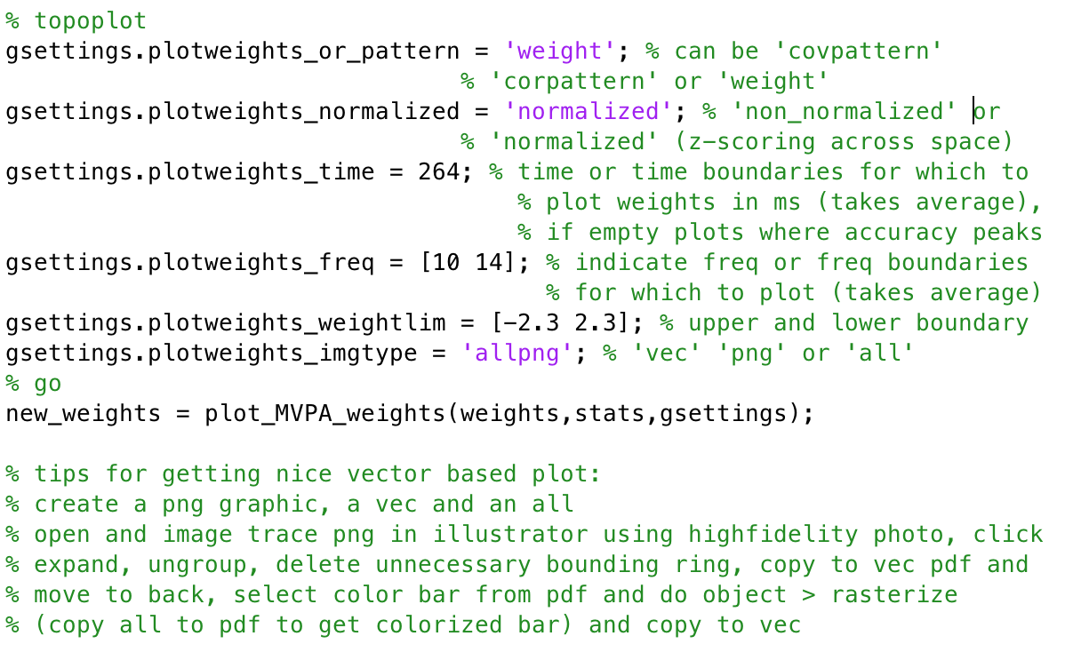
Weight and source topoplots
correlation/class separability map

Slide 50
weights (left) and correlation/class separability map(right)
Of course you can also plot based on covariance matrix, see Haufe (2014) for details

Slide 51

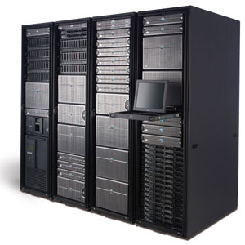
So what about automation, Lisa etc?
Lisa cluster
Local machine
Preprocessing
MVPA analysis
Visualization
Group stats
Preprocessing
MVPA analysis

Slide 52
Running jobs on Lisa
Functionality - two core functions:
create_qsub_files.m
run_local_instead_of_qsub.m
Always the same structure: create_qsub_files(path_to_function, function_name, qsettings, <varargs belonging to function: filepath,filenames,outpath, varargs etc>)

Slide 53
create_qsub_files.m
Allows you to run all your subjects and all your parameter combinations in a single command
Very powerful, but requires a bit of setup
Creates job on Lisa computing cluster, which can be submitted and then creates all the output at once
Will discuss this in detail another time, first process all of this, if some of you are interested, I will set up a second meeting to go over this

Slide 54
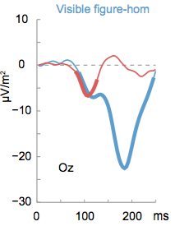
ERP
Determine electrodes show the biggest effect
Plot average for the conditions (and/or their difference + topomap of difference)

